Slide 1
PREPARATION of ABSTRACT
Due 30 April 2020

Slide 2
Abstract
An abstract of the research paper is a short summary that provides general information about the work and outlines the methods.
summarizing the actions of the author, but not the topic of the research itself.
What is more, one of the main requirements for such writing is its brevity (250-300 words).

Slide 3
Main points of the research paper abstract.
Objectives of the research;
Methods used;
Findings;
Short conclusions;

Slide 4
Objectives
begin with stating the problem your research deals with.
So, your main objective is to solve this problem.
It is also recommended to write several words about the topic and why it is important to study it.

Slide 5
Methods
the way the above mentioned problem was solved or explored.
describe a process, with the help of which the research was conducted.

Slide 6
Finding
Here you should just say a few words about the results of your research
Mentioning about your system prototype → advantages

Slide 7
Conclusions
Contribution of your research/system

Slide 8
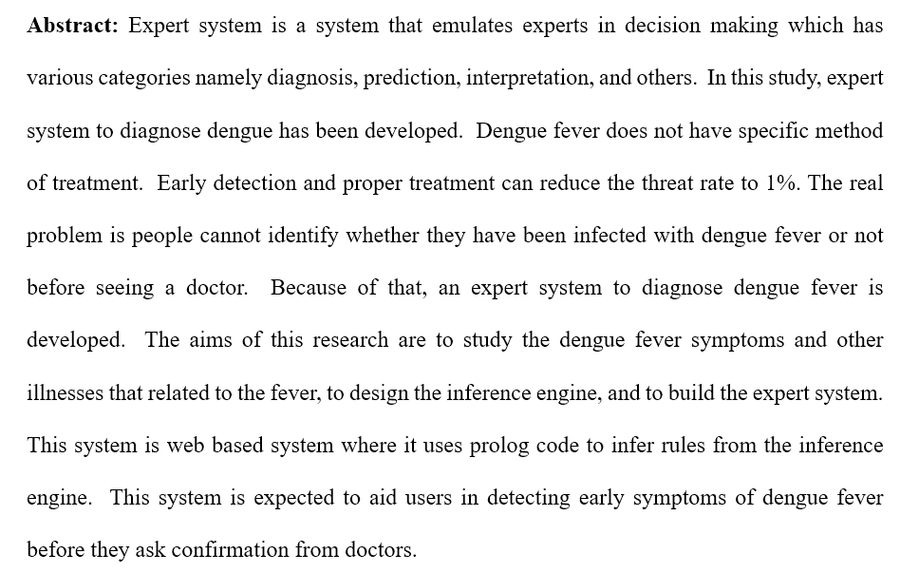
Sample abstract

